Slide 1
Welcome to Hello World Series
What is GIT

Slide 2
In last tutorial...
We listed few popular Distributed Version Control Systems like Git, Mercurial, Bazaar & Darcs.

Slide 3
In this tutorial...
We will see, We will start our journey with GIT.

Slide 4
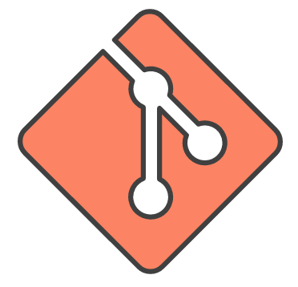
Some well known DVCS - GIT
Git is a Distributed Version Control System (VCS).

Slide 5
Some well known DVCS - GIT
It takes a “peer-to-peer” approach to version control as opposed to a “Client-Server” approach like version control systems like Subversion (SVN).

Slide 6
Some well known DVCS - GIT
Matthew McCullough, a trainer at GitHub, explains that Git, like other version control systems, manages and stores revisions of projects.

Slide 7
Some well known DVCS - GIT
Though it’s mostly used for code, McCullough says Git could be used to manage any other type of file, such as Word documents or Final Cut projects.

Slide 8
Got ever confused with GIT and GitHub
Watch next tutorial to clear the doubt…

Slide 9
Coming up Next
What is GitHub
Notes:
In Slide Show mode, click the arrow to enter the PowerPoint Getting Started Center.

